Slide 1
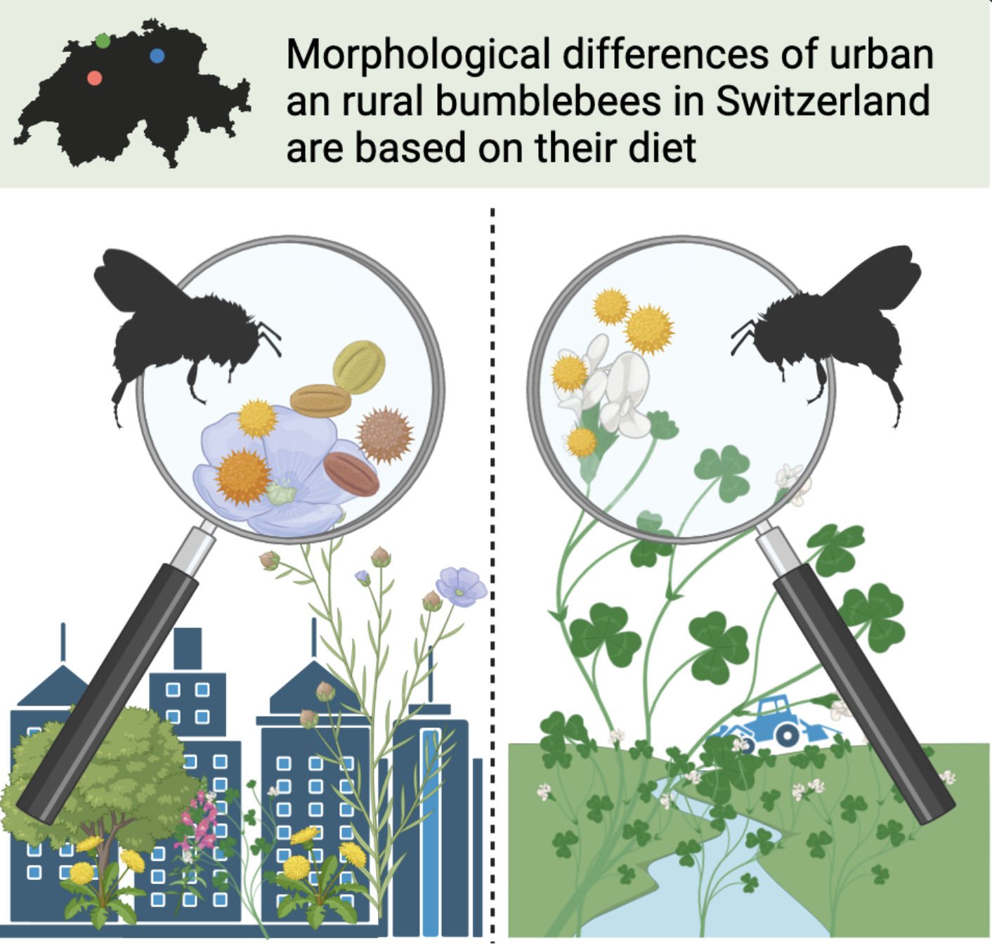

Slide 2
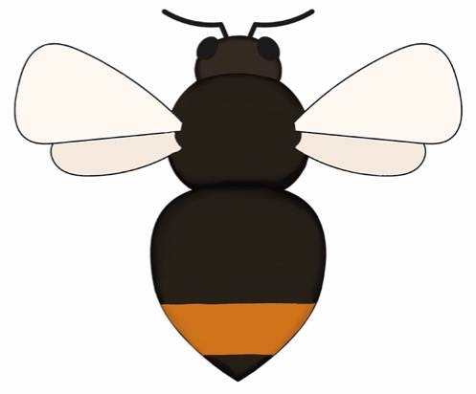
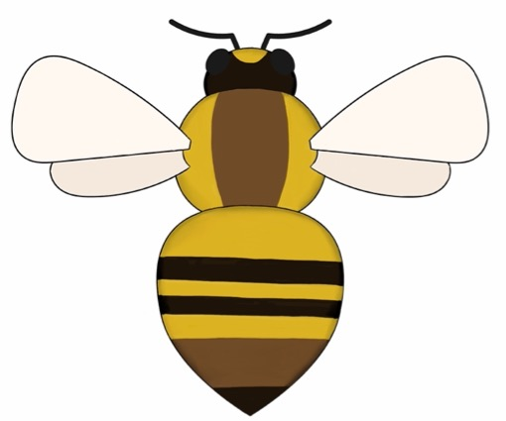
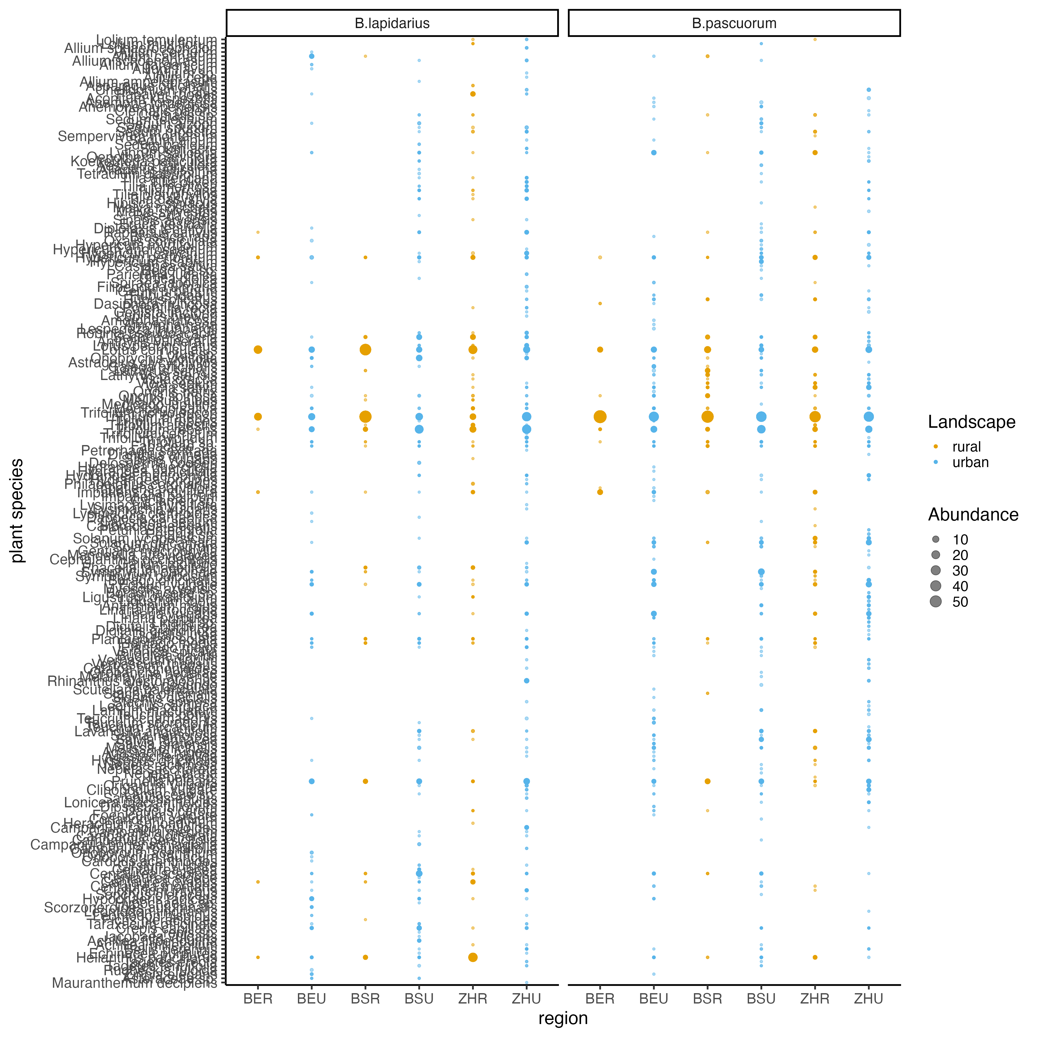
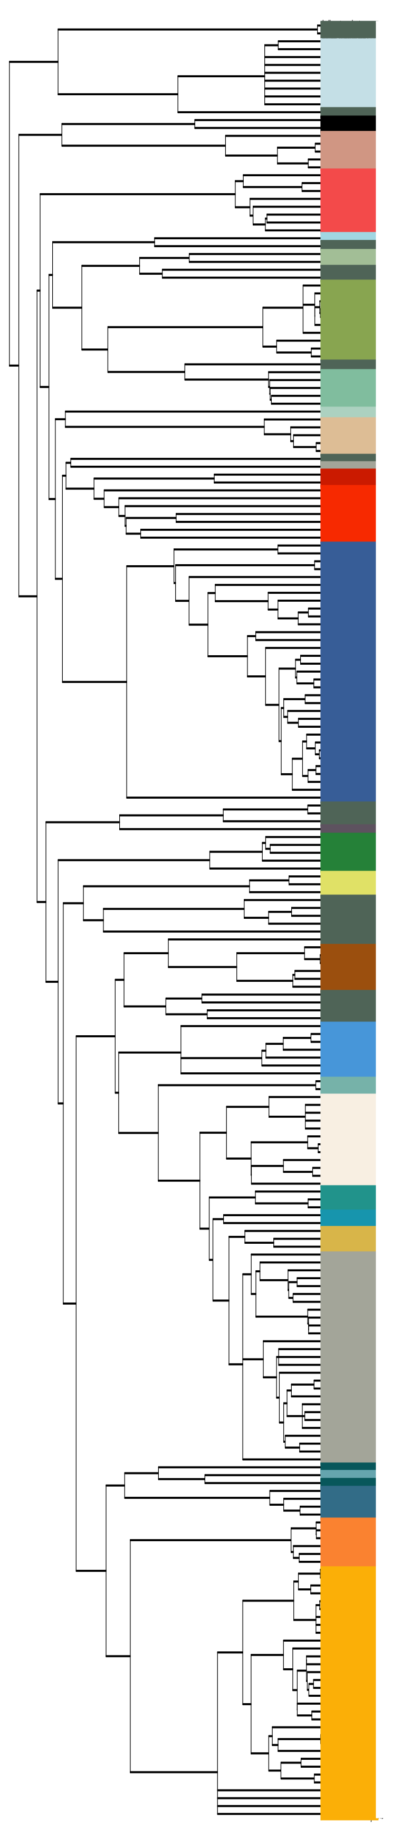
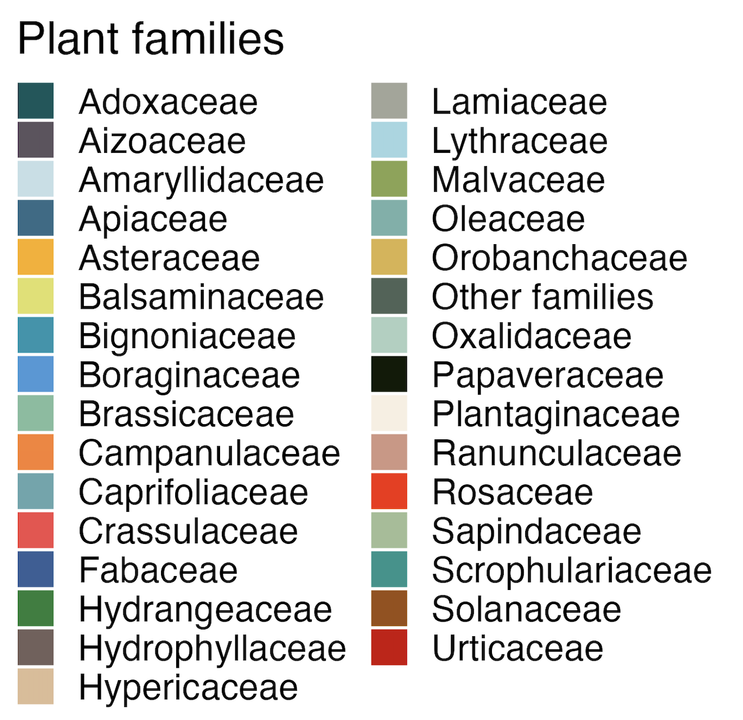
Taxa
31
86
48
24
54
9
91
8
52
77
100
77
Bern
Basel
Zurich
region
Bern
Basel
Zurich

Slide 3
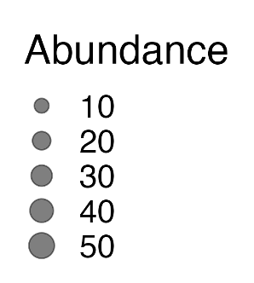
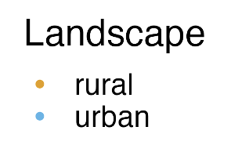
Taxa
31
86
48
24
54
9
91
8
52
77
100
77
Bern
Basel
Zurich
region
Bern
Basel
Zurich

Slide 5
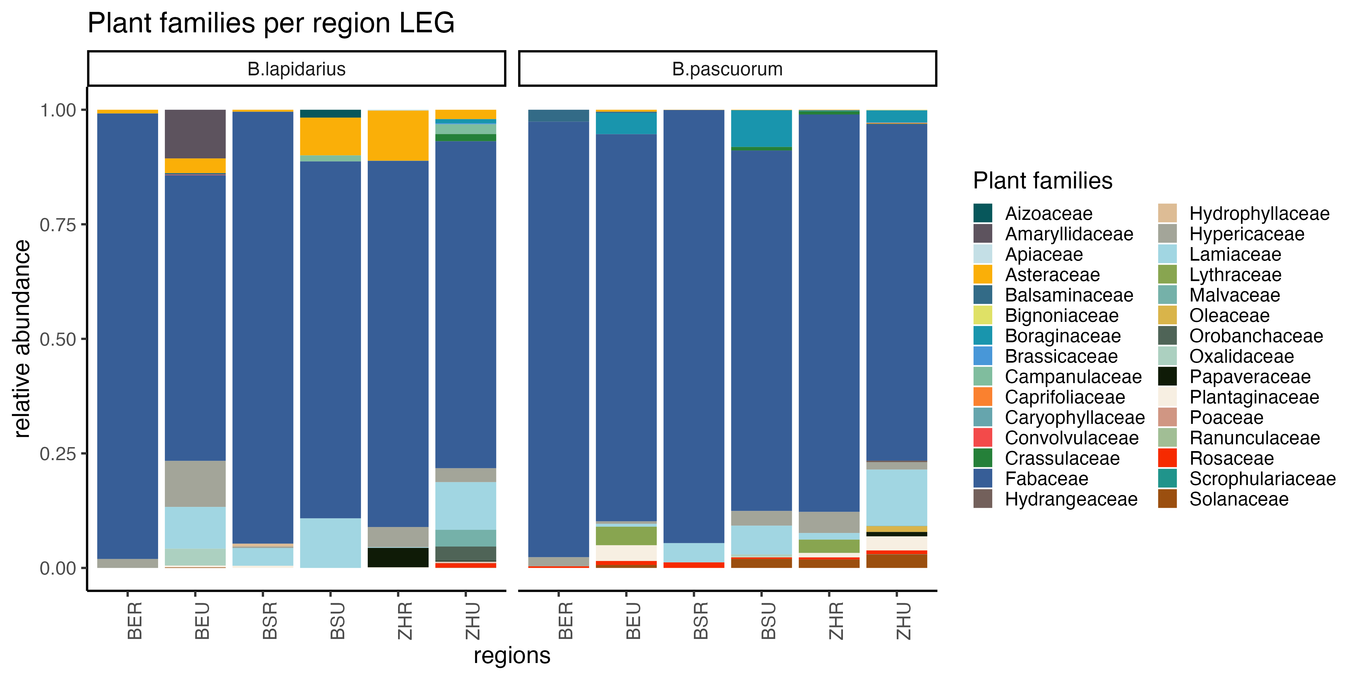

Slide 6
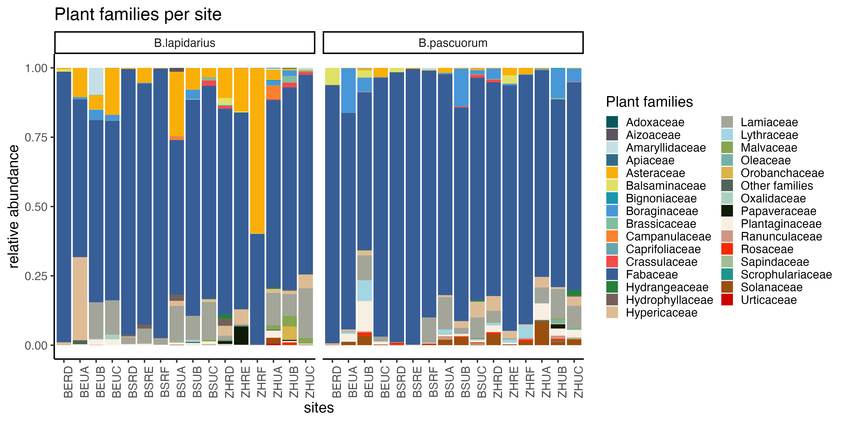

Slide 7
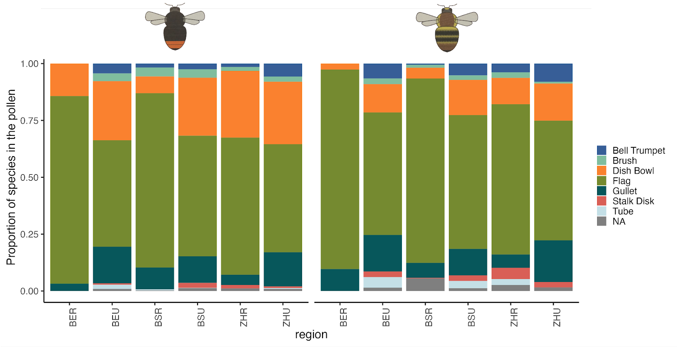
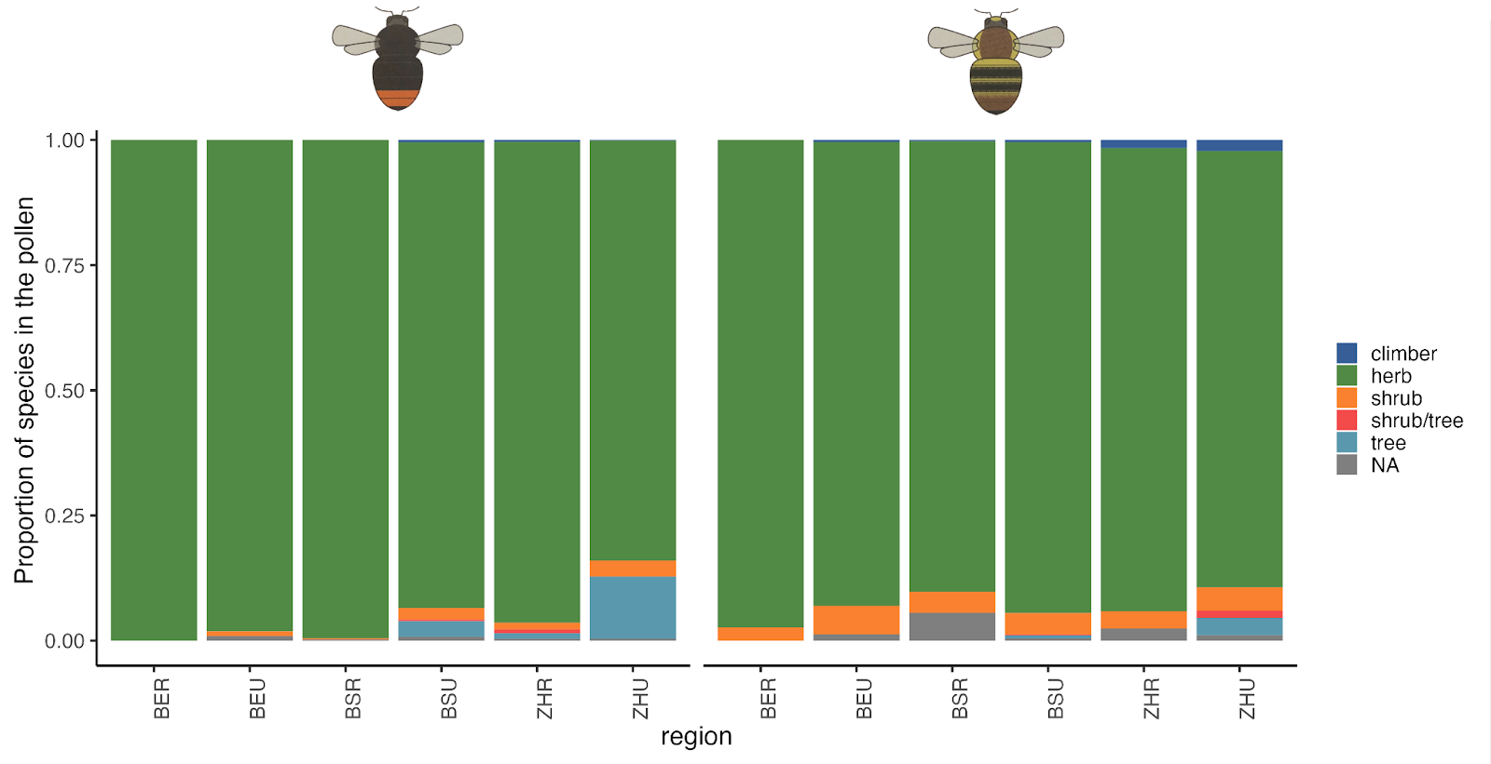
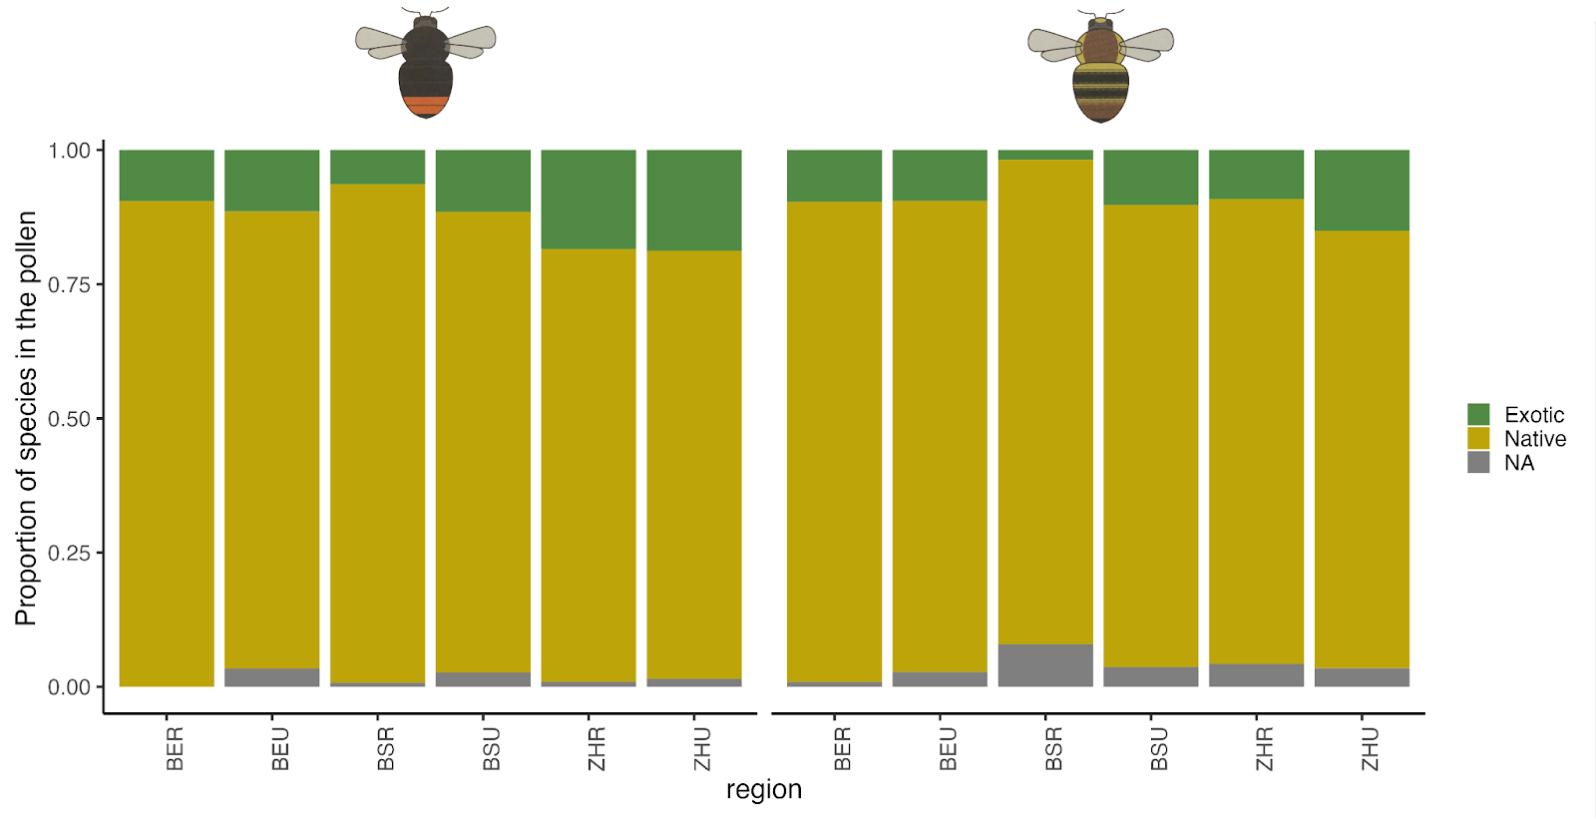

Slide 8
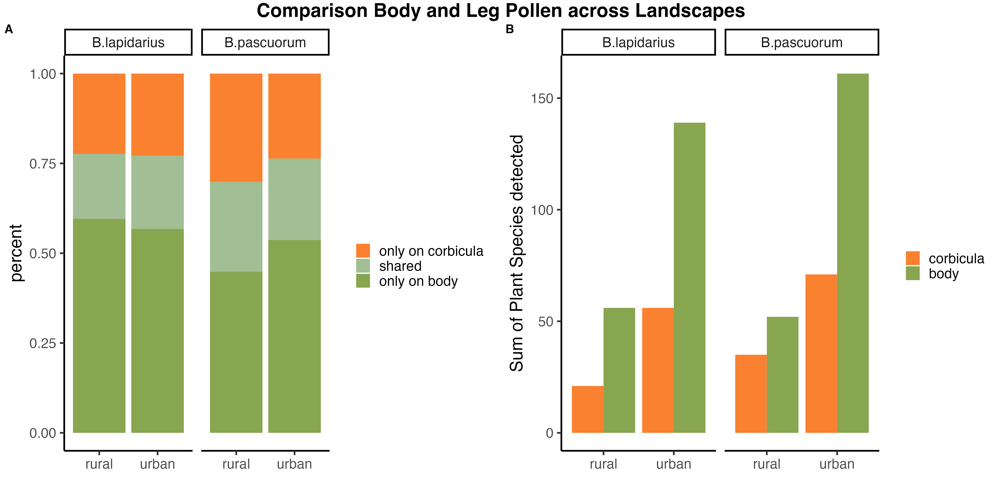

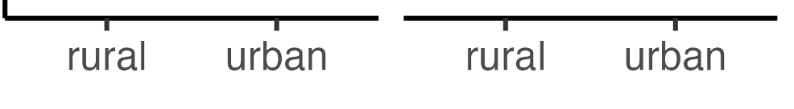

Slide 9
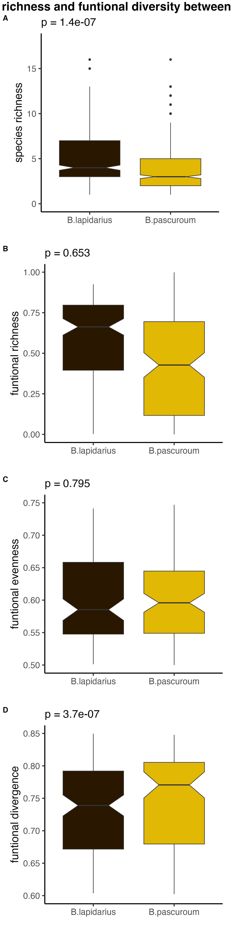
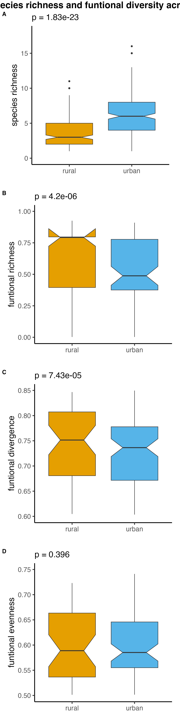
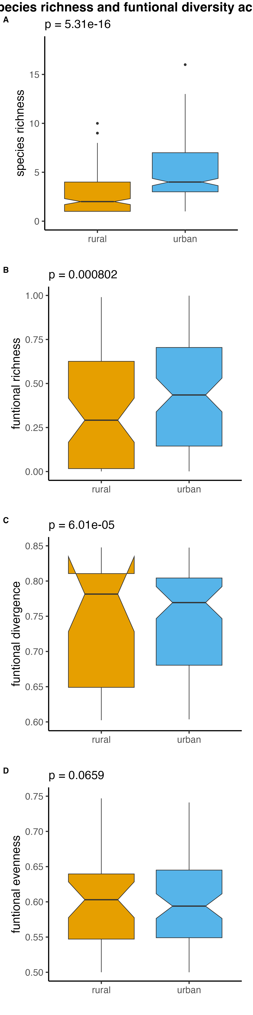
A
***
A
***
***
B
n = 478
n = 535
B
n = 233
n = 245
n = 243
n = 292
B
***
***
C
n = 363
n = 333
C
n = 143
n = 220
n = 110
n = 223
D
n = 363
n = 333
D
n = 143
n = 220
n = 110
n = 223
***
***
***
n = 363
n = 333
n = 143
n = 220
n = 110
n = 223

Slide 10
A
***
***
B
n = 233
n = 245
n = 243
n = 292
B
***
***
C
n = 143
n = 220
n = 110
n = 223
D
n = 143
n = 220
n = 110
n = 223
***
***
n = 143
n = 220
n = 110
n = 223

Slide 11
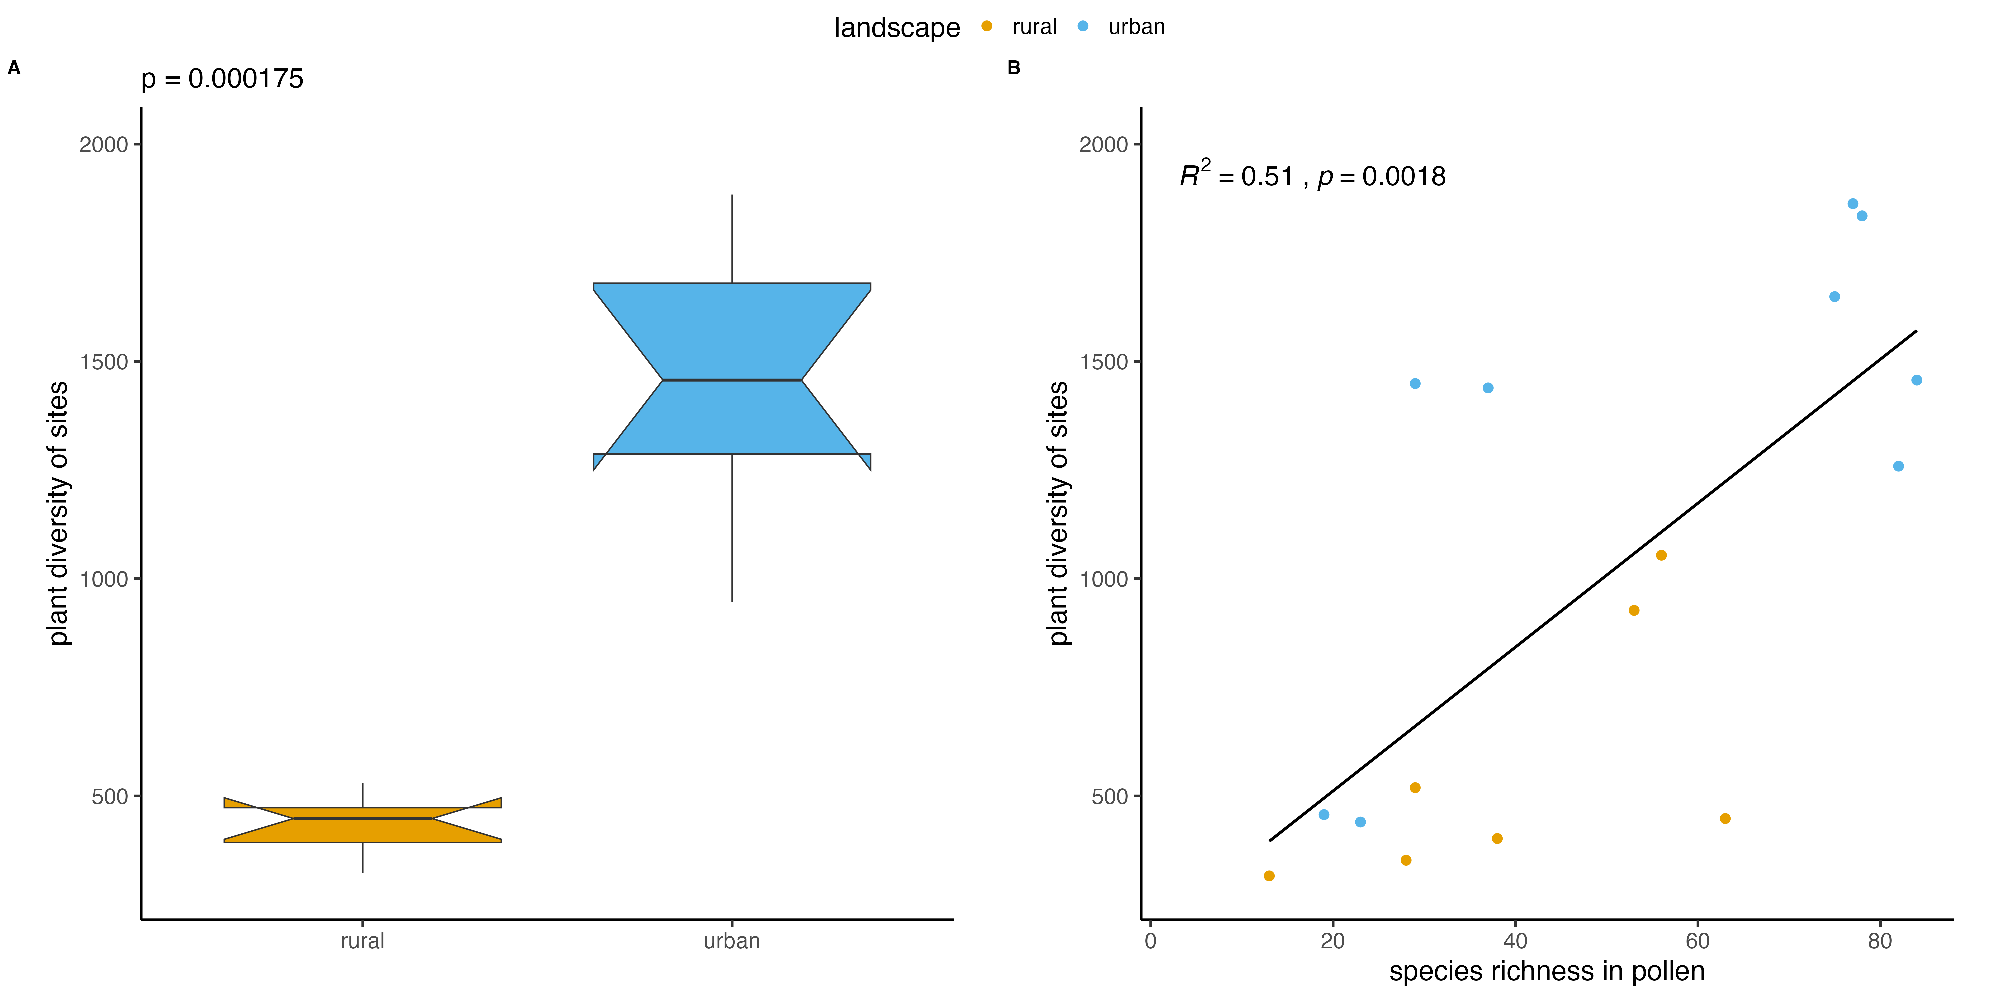
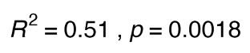


Slide 12
A
B

Slide 13
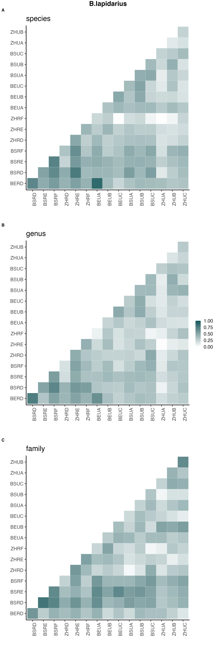
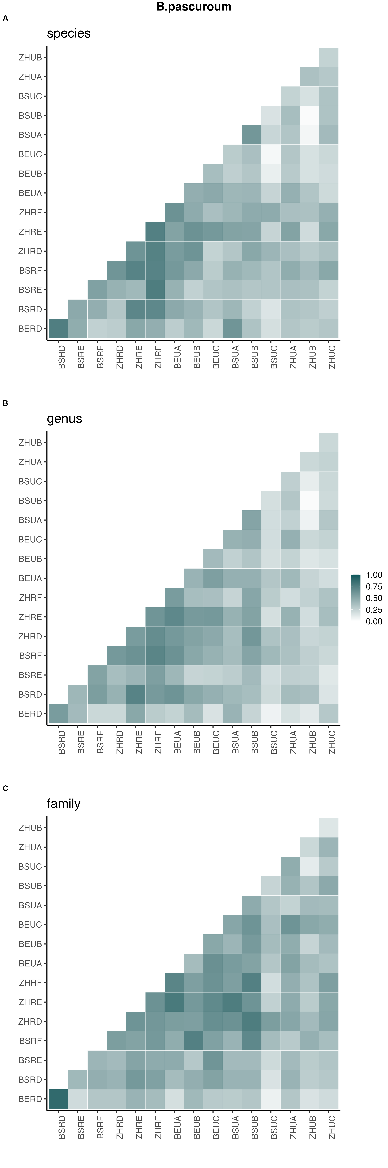
A
B
C

Slide 14
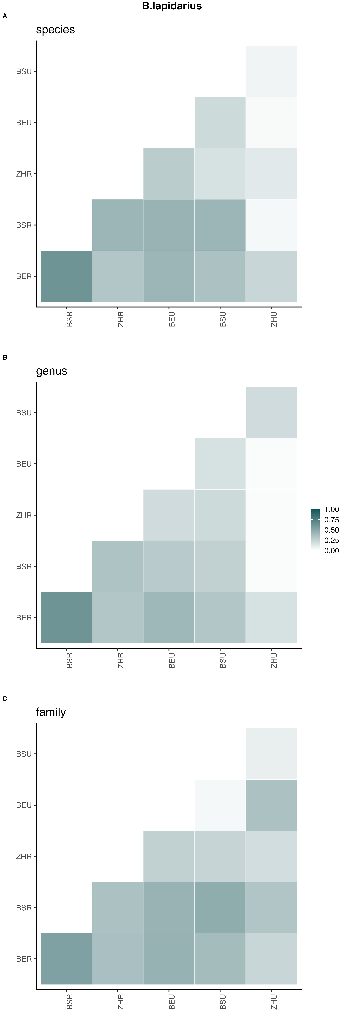
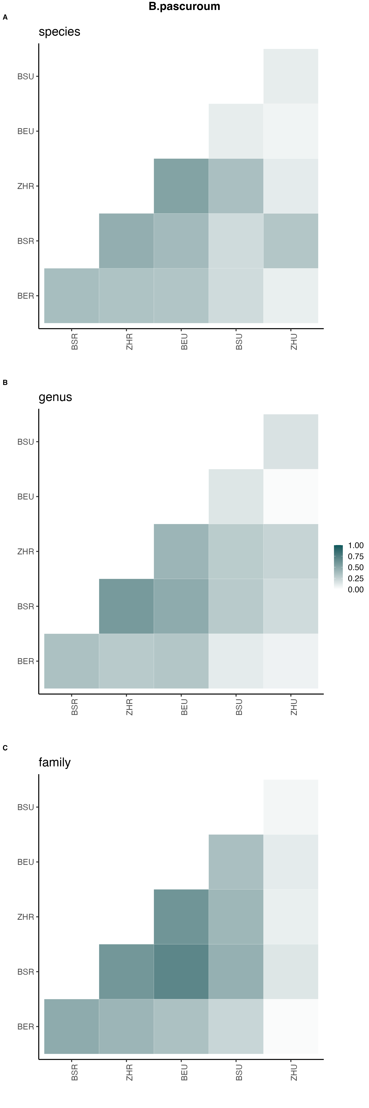
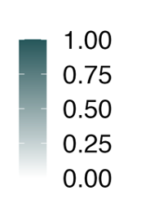
A
Basel
Basel
Basel
Basel
urban
urban
Bern
Bern
Bern
Bern
Zurich
Zurich
Zurich
Zurich
Basel
Basel
rural
rural
Basel
Basel
Bern
Bern
Bern
Bern
rural
urban
rural
urban
B
Basel
Zurich
Bern
Basel
Zurich
Basel
Zurich
Bern
Basel
Zurich
Basel
Basel
Basel
urban
urban
Bern
Bern
Bern
Zurich
Zurich
Zurich
Basel
Basel
rural
rural
Basel
Bern
Bern
Bern
rural
urban
rural
urban
C
Basel
Zurich
Bern
Basel
Zurich
Basel
Zurich
Bern
Basel
Zurich
Basel
Basel
Basel
urban
Basel
Bern
urban
Bern
Bern
Bern
Zurich
Zurich
Zurich
Zurich
Basel
Basel
rural
Basel
Basel
rural
Bern
Bern
Bern
Bern
rural
urban
rural
urban
Basel
Zurich
Bern
Basel
Zurich
Basel
Zurich
Bern
Basel
Zurich

Slide 15
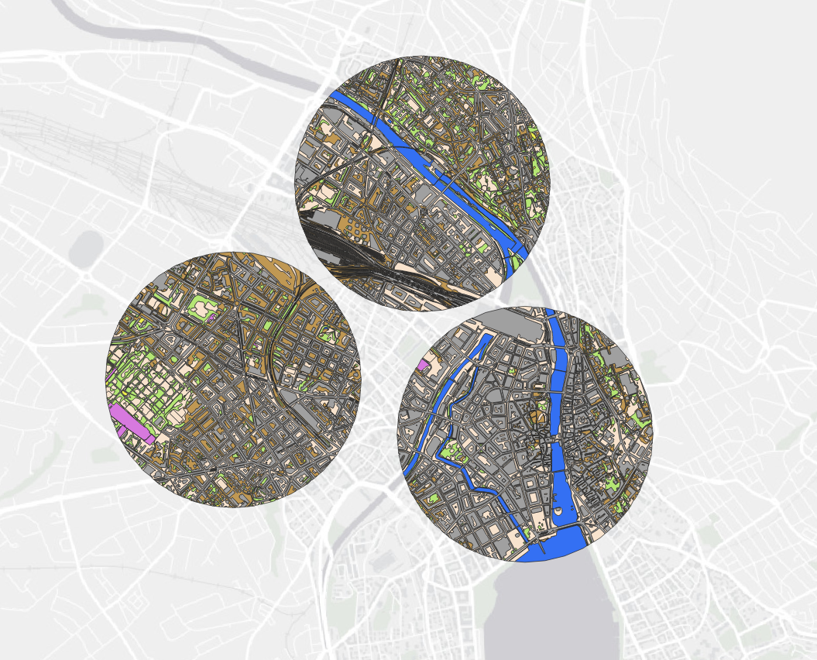
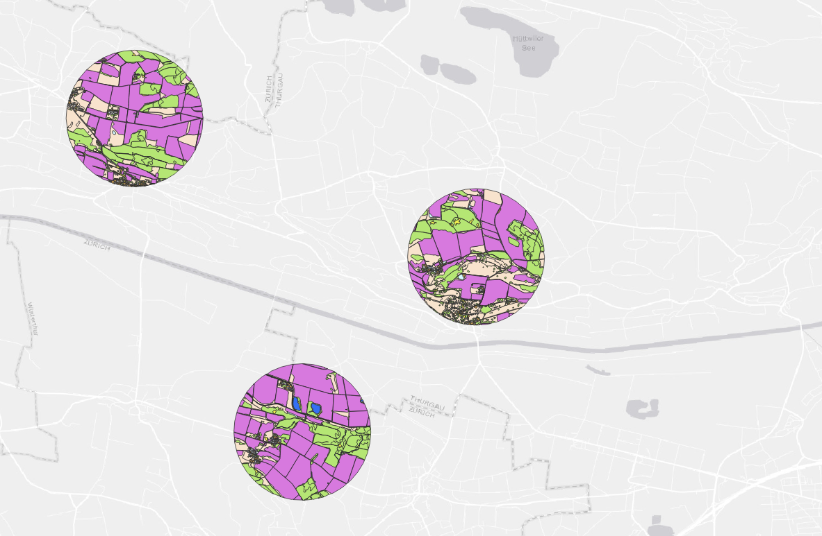

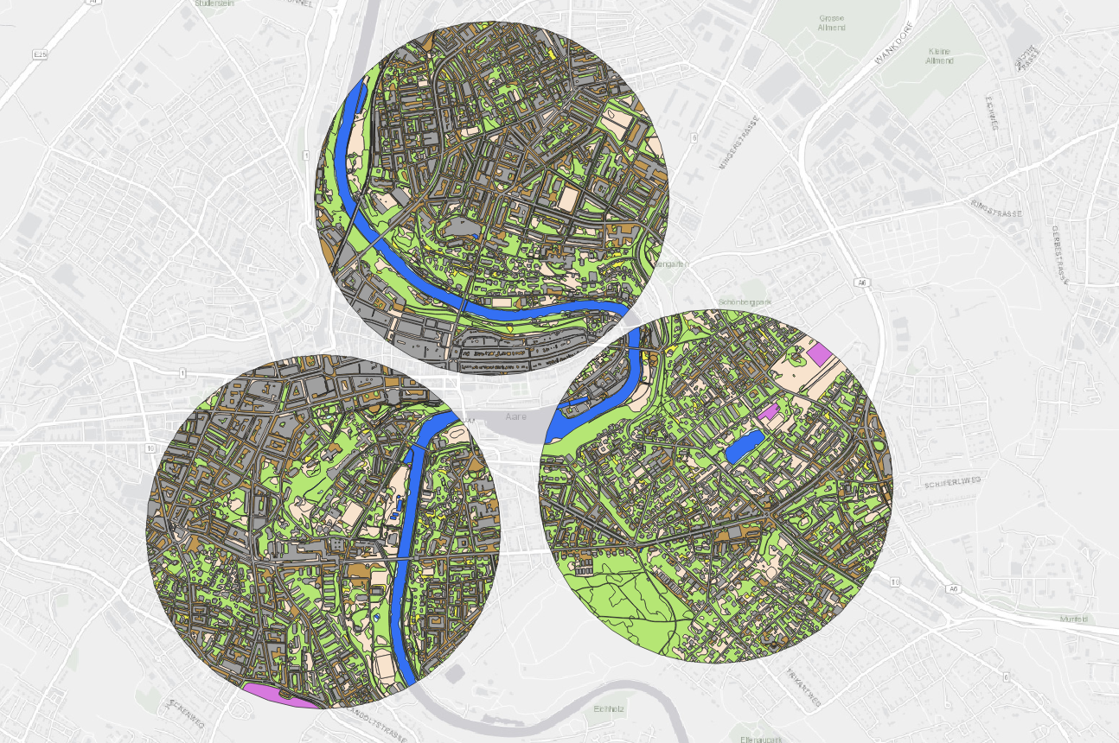
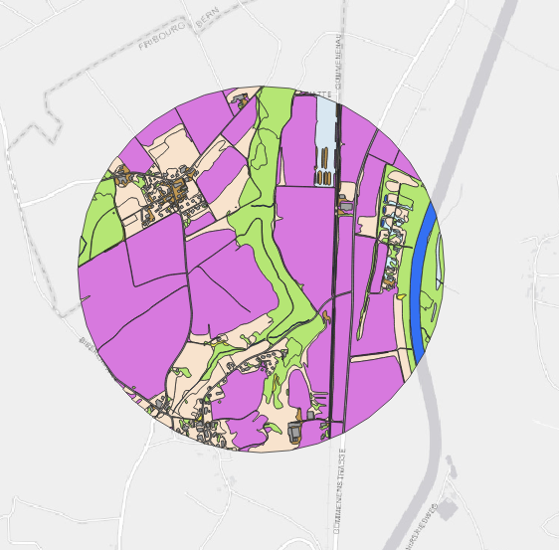
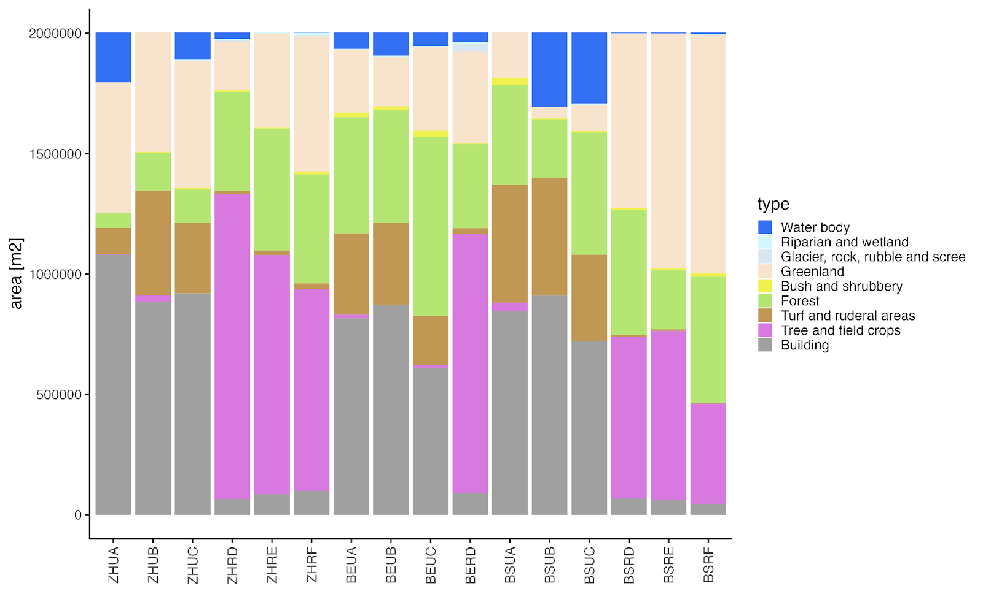
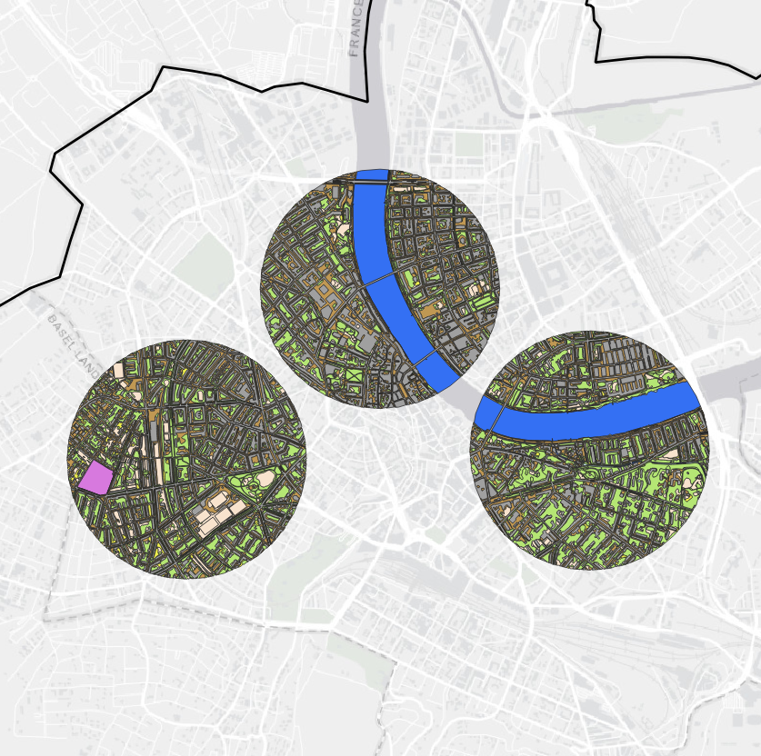
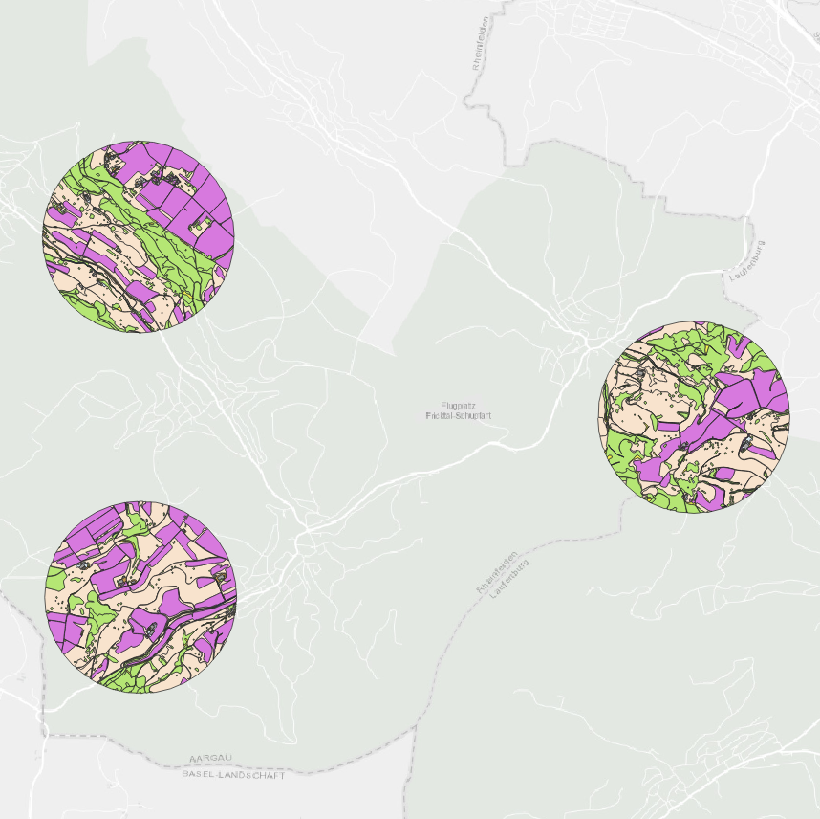
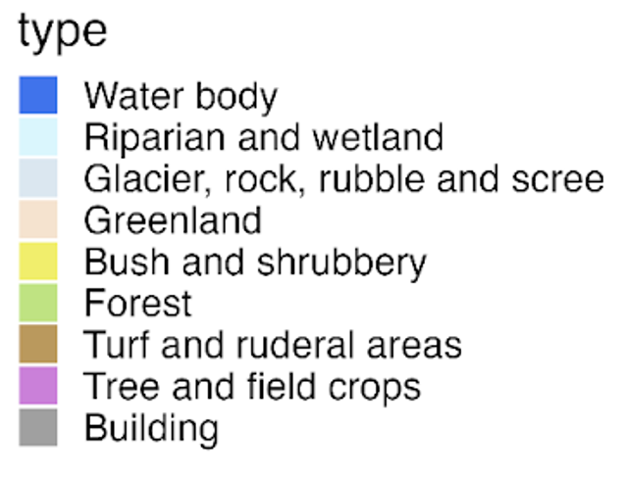
A
C
E
B
B
A
F
D
Zurich urban
500 m
Zurich rural
1 km
B
100 km
D
C
A
C
Bern urban
500 m
Bern rural
500m
B
D
A
C
F
E
Basel urban
500 m
Basel rural
1 km

Slide 16
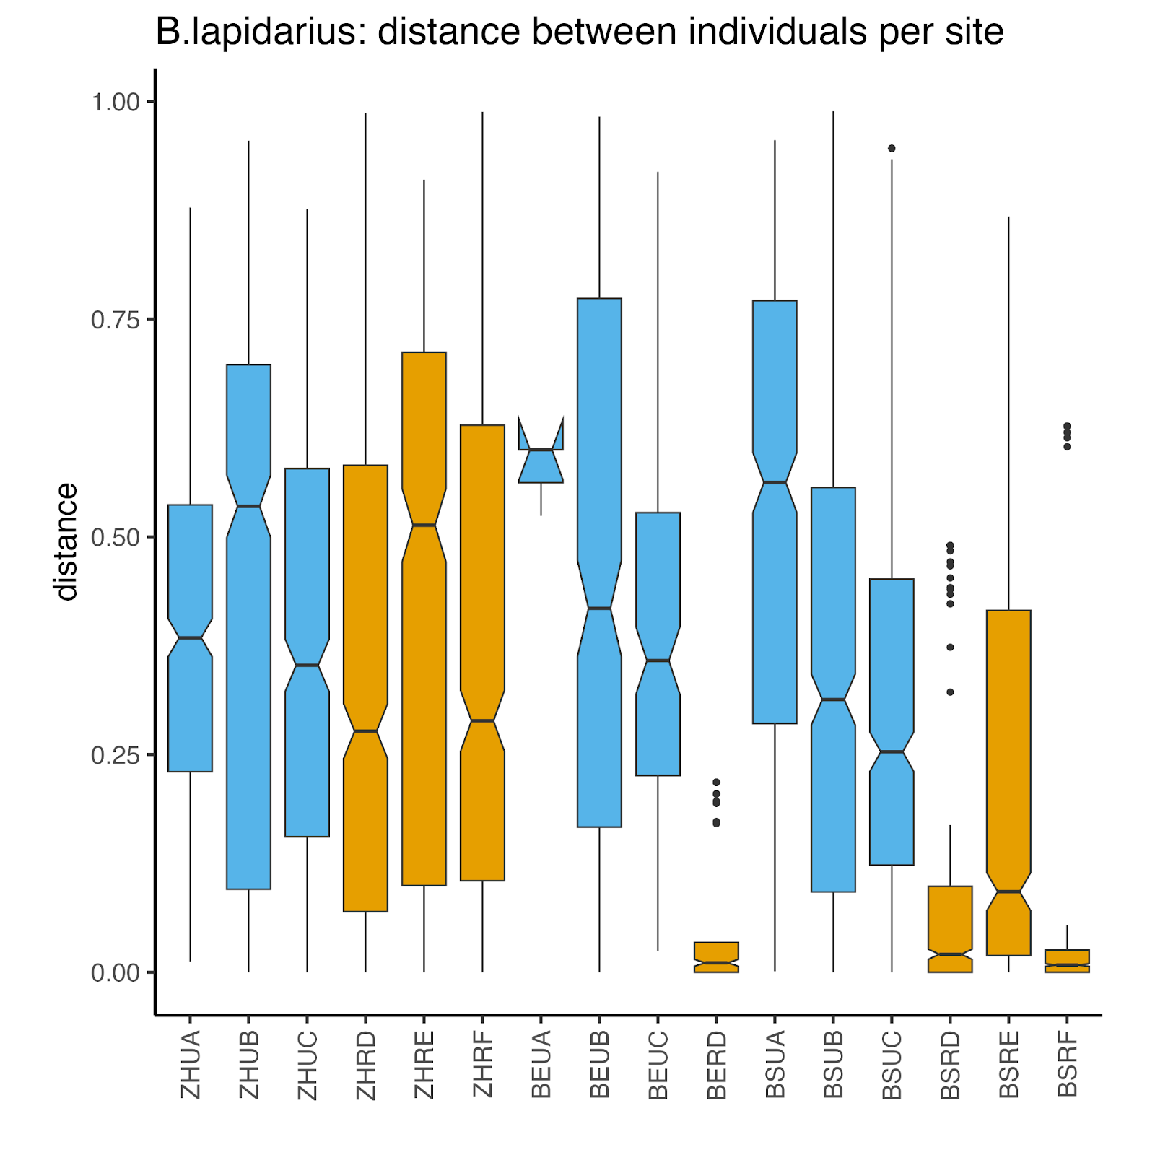
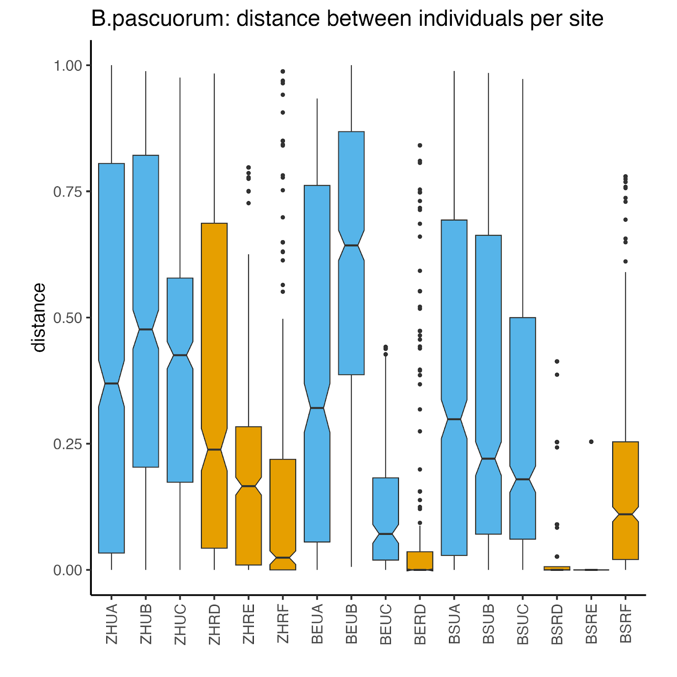

Slide 17
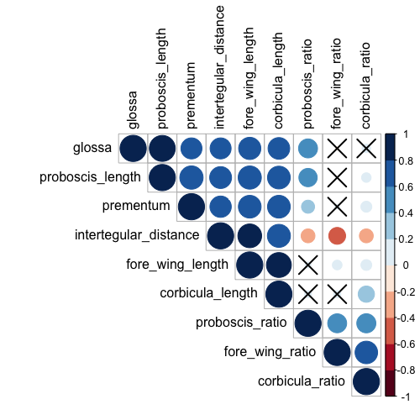
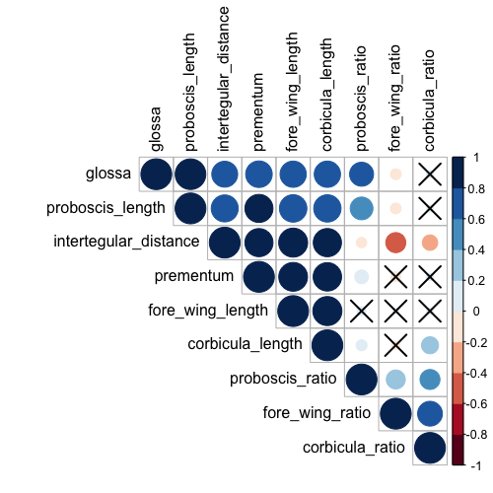

Slide 18
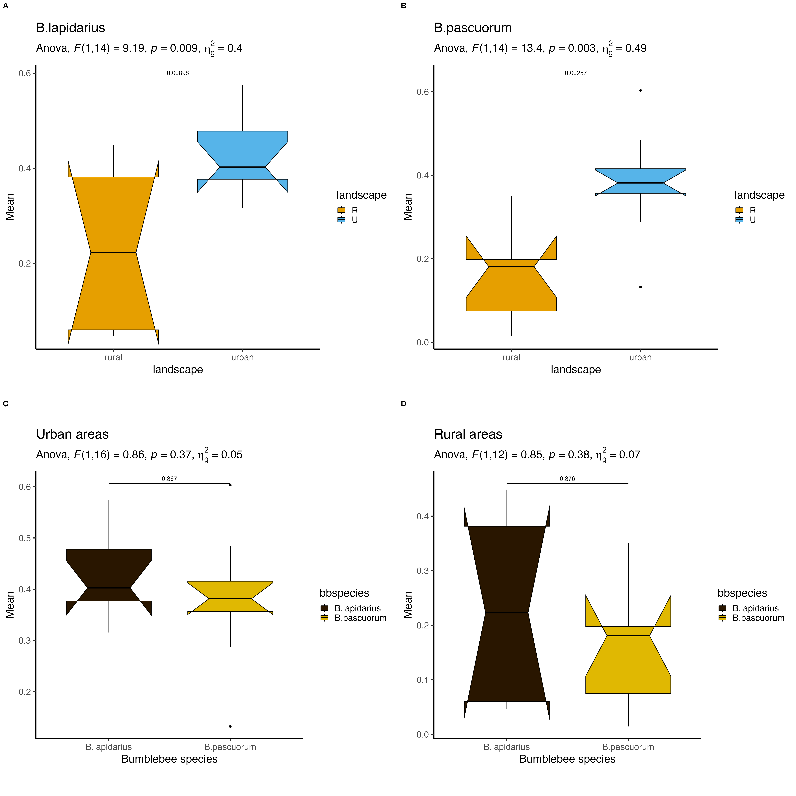
A
B
C
D

Slide 19
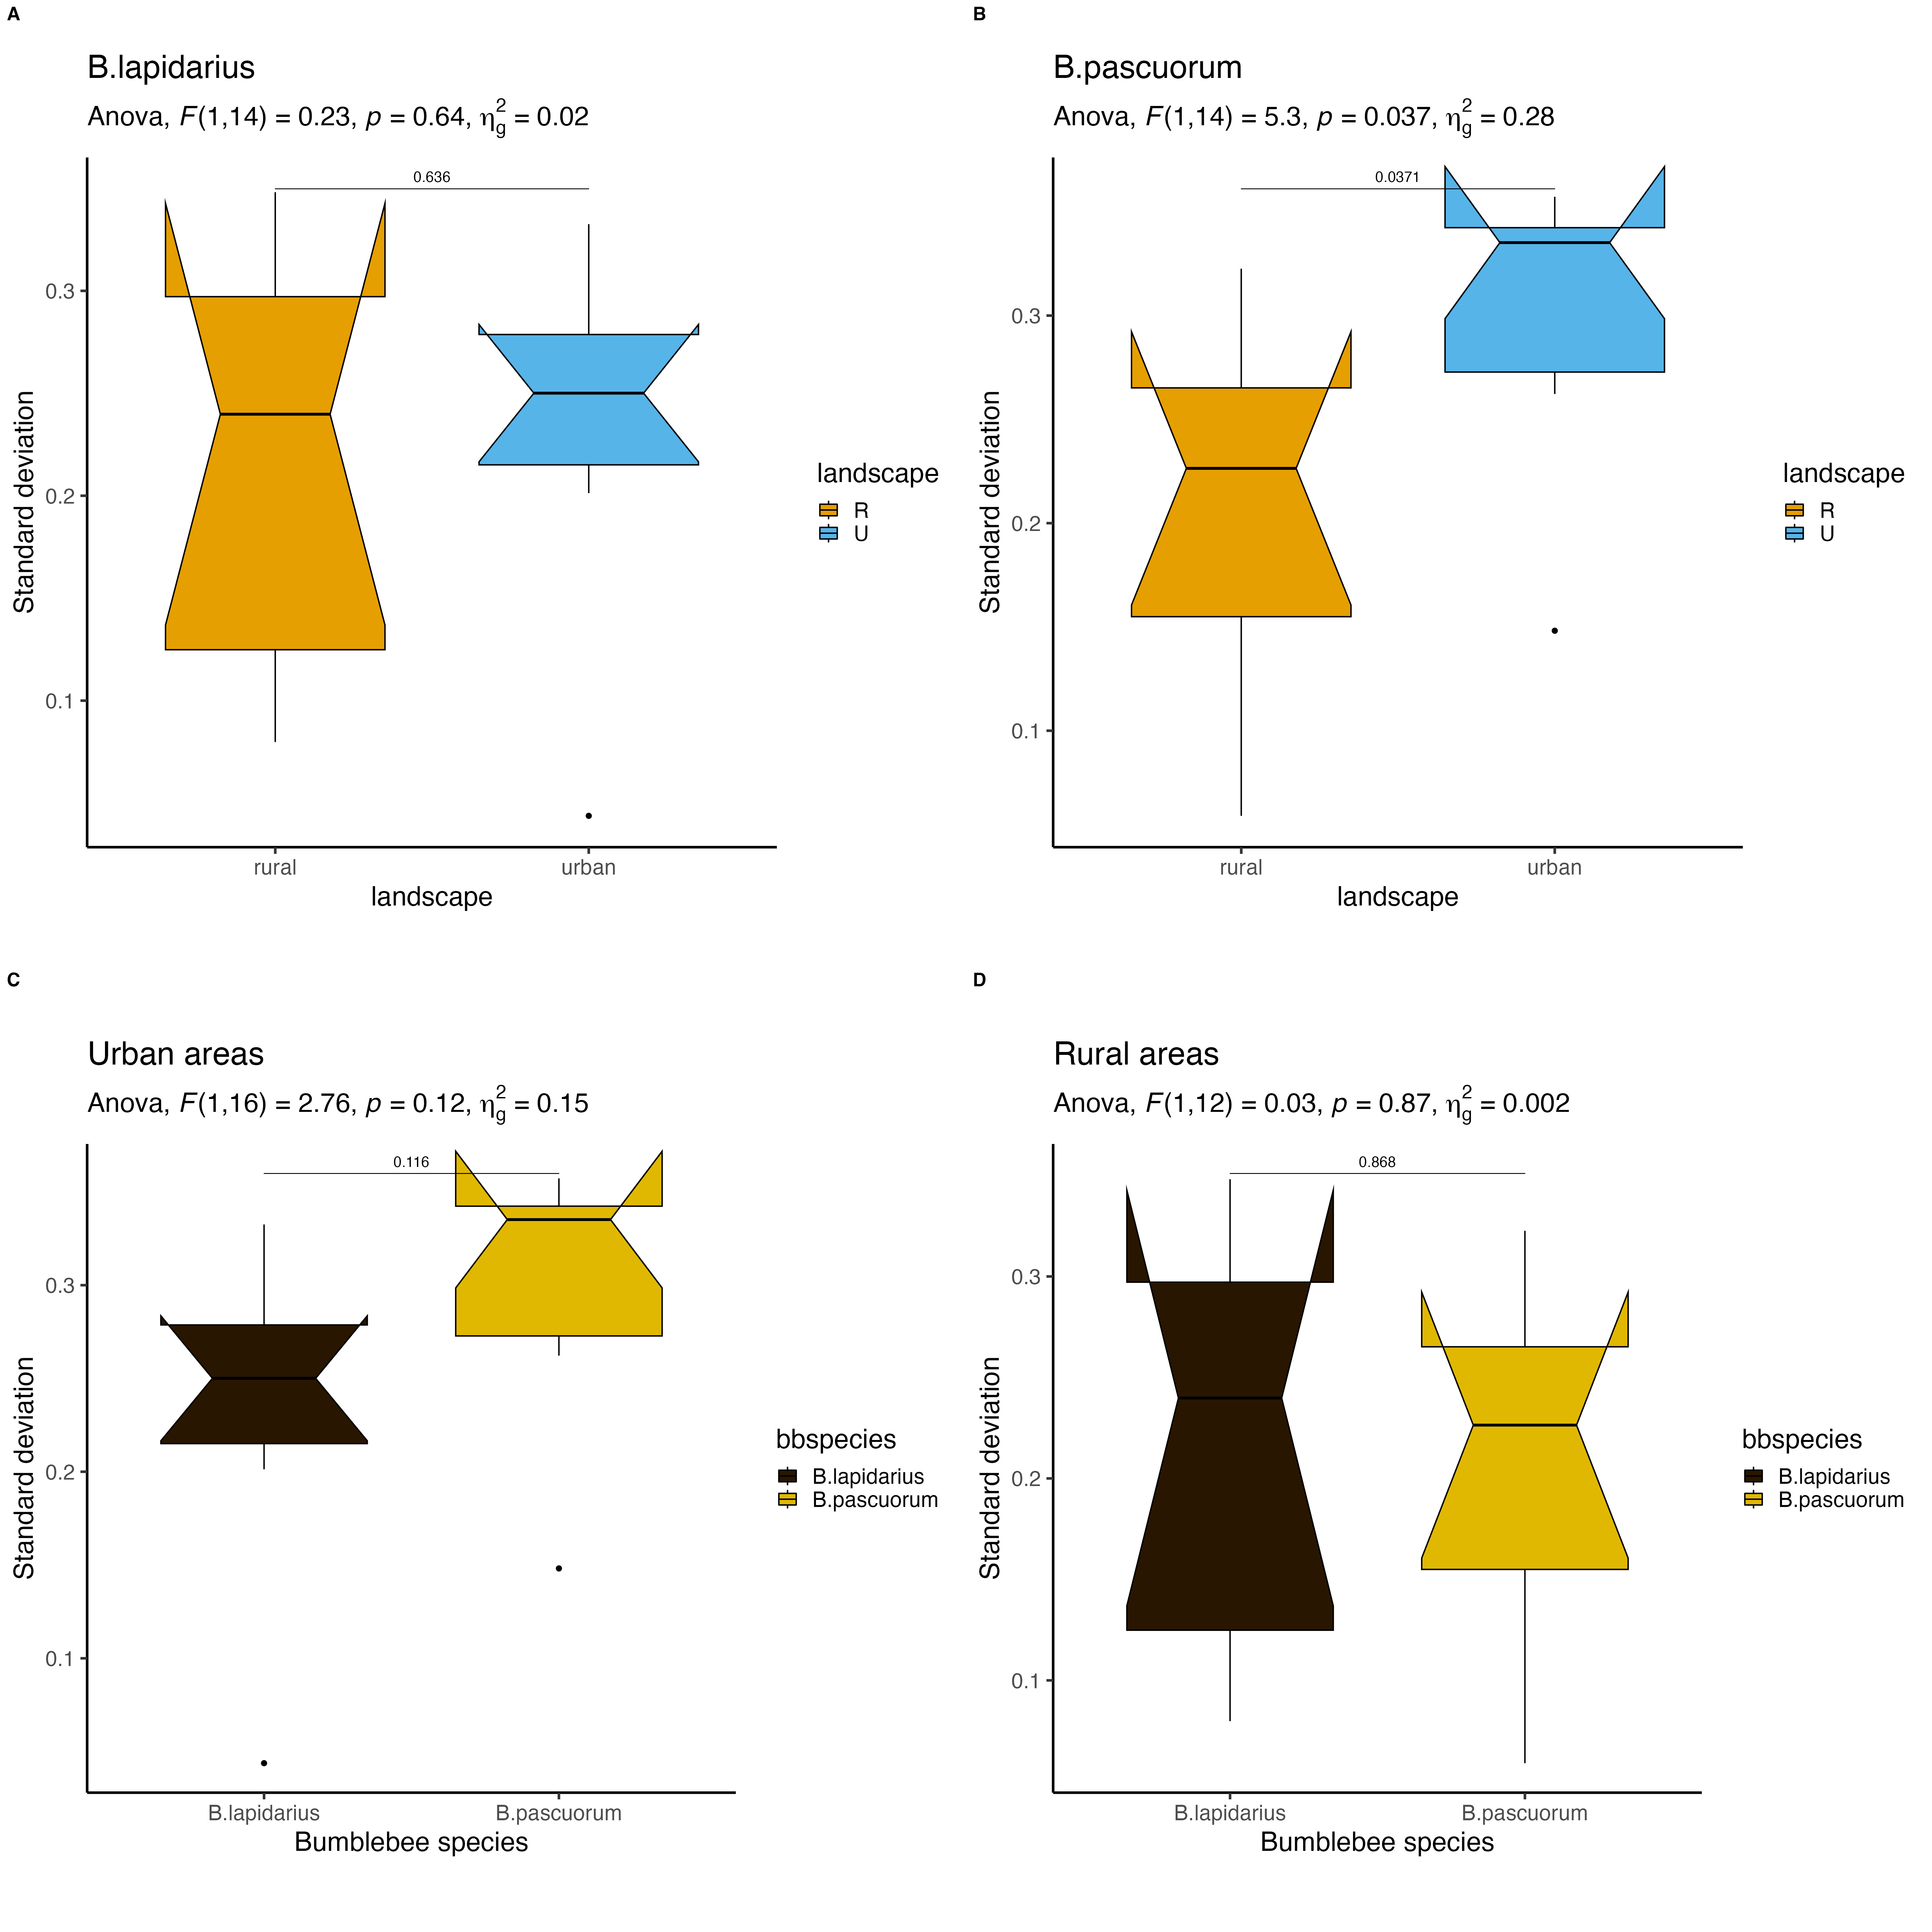
A
B
C
D

Slide 20
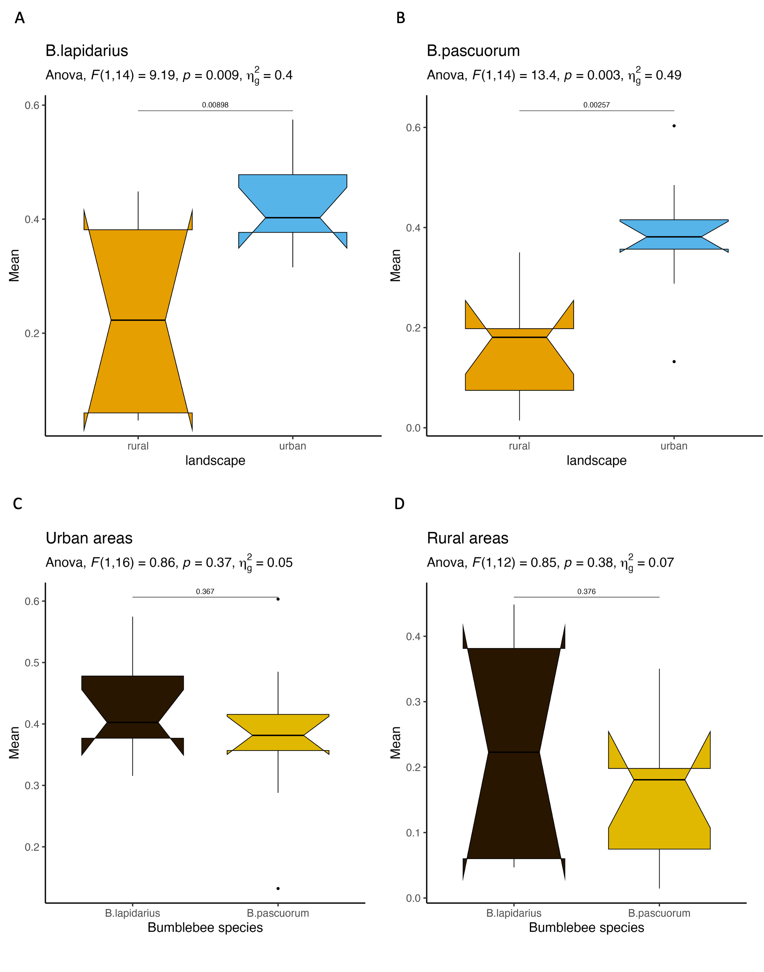
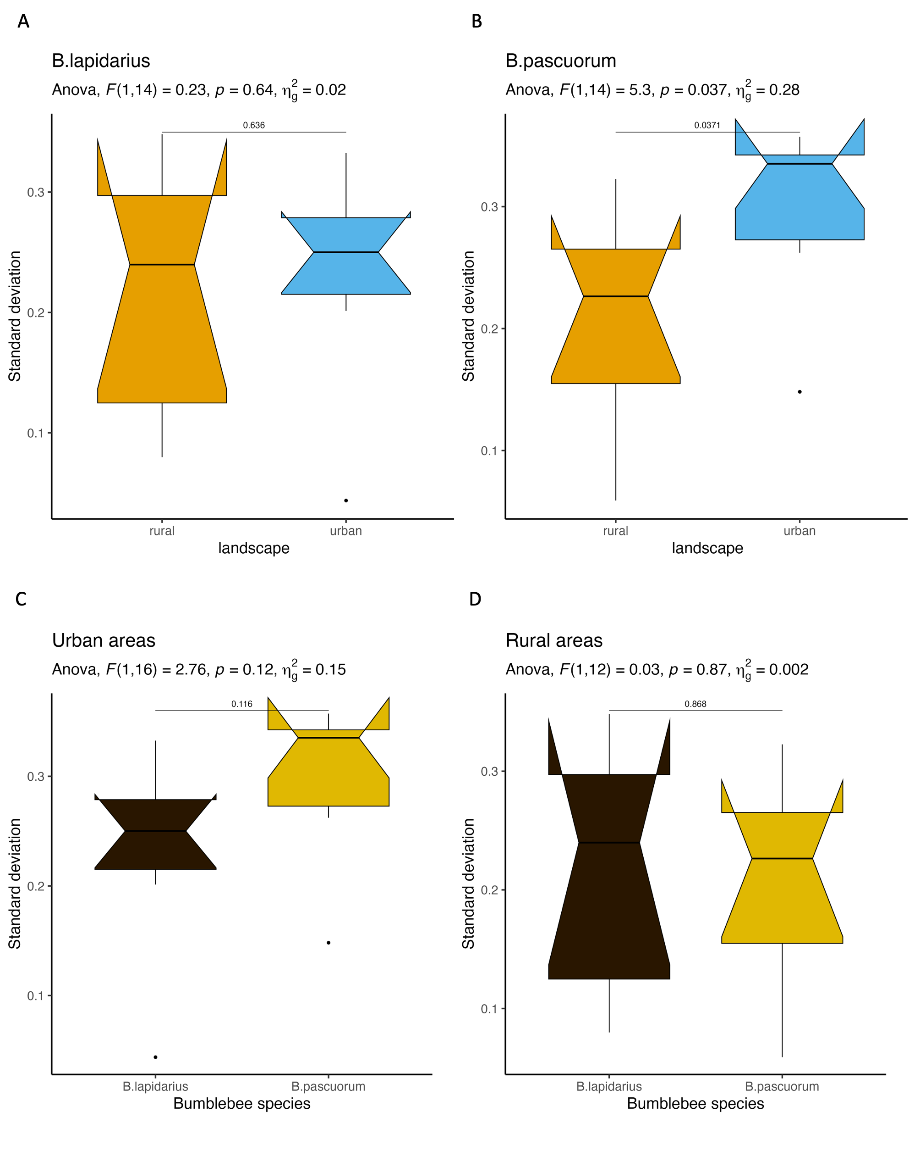

Slide 22
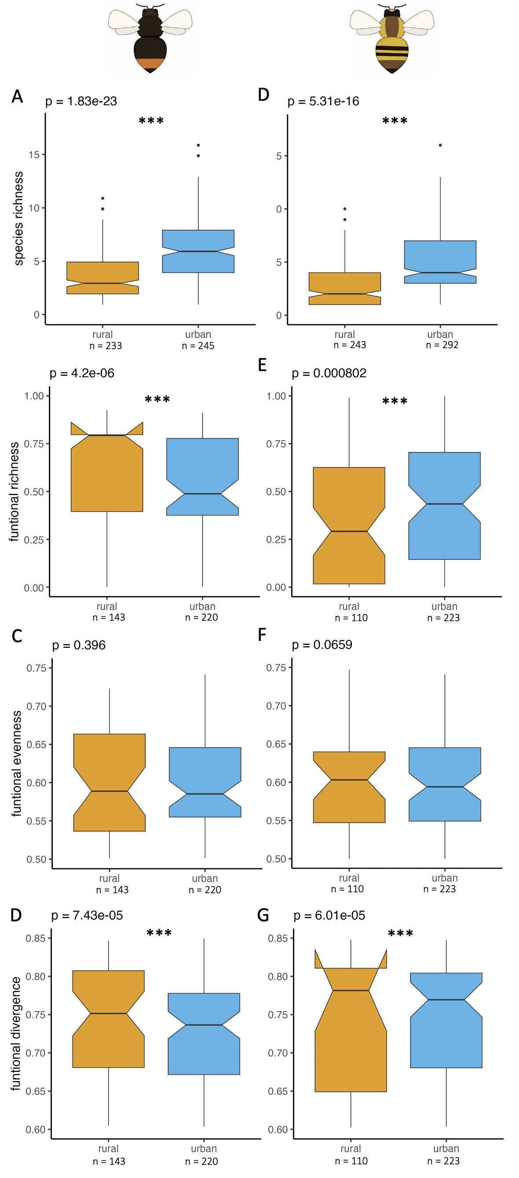
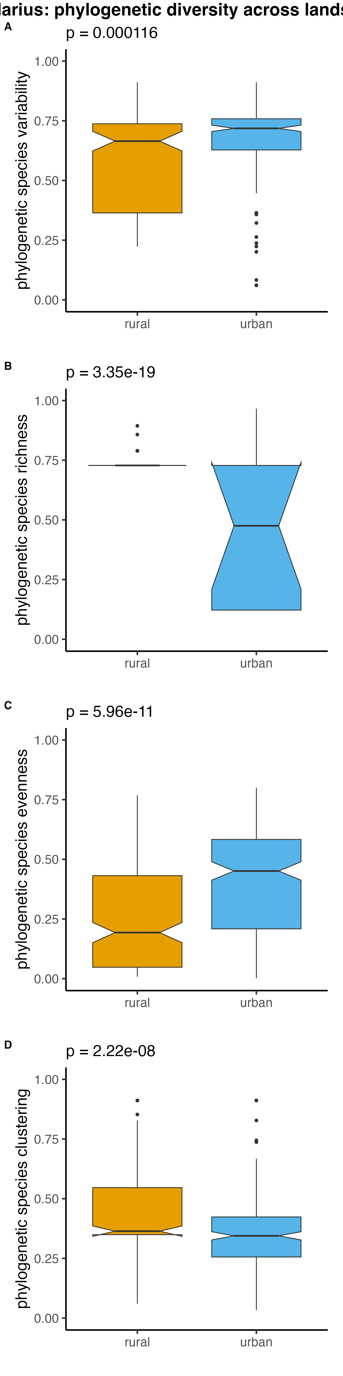
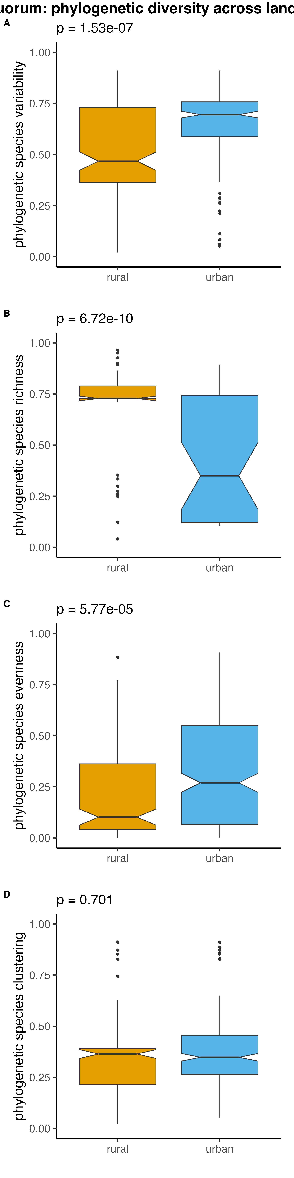
A
***
n = 205
n = 236
B
A
***
n = 168
n = 269

Slide 23
A
***
n = 168
n = 269

Slide 24
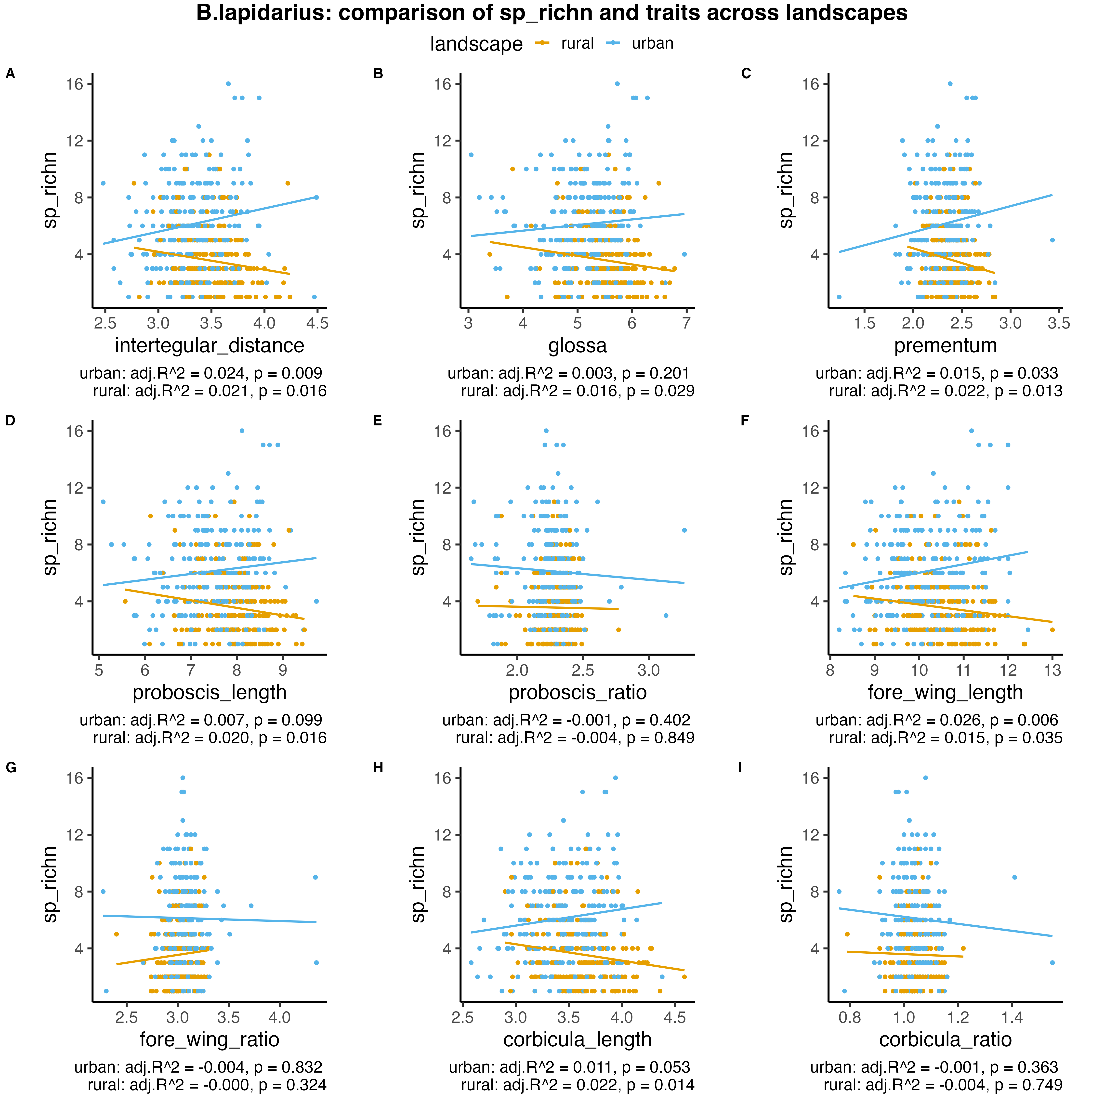
landscape
NrSpecies
NrSpecies
NrSpecies
intertegular distance
glossa
prementum
NrSpecies
NrSpecies
NrSpecies
proboscis length
proboscis ratio
fore wing length
NrSpecies
NrSpecies
NrSpecies
fore wing ratio
corbicula length
corbicula ratio

Slide 25
